Slide 1
Chapter 8 Multidimensional Arrays

Slide 2
Motivations
Thus far, you have used one-dimensional arrays to model linear collections of elements.
You can use a two-dimensional array to represent a matrix or a table.
For example, the following table that describes the distances between the cities can be represented using a two-dimensional array.

Slide 3
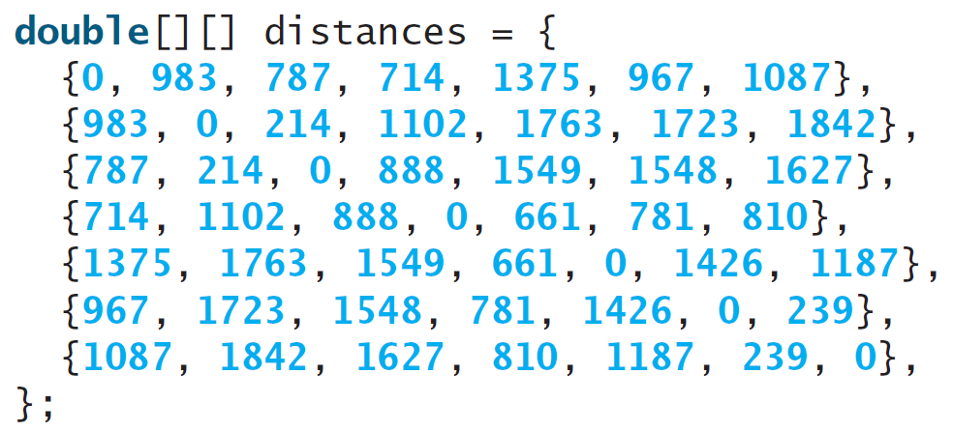
Motivations

Slide 4
Objectives
To give examples of representing data using two-dimensional arrays (§8.1).
To declare variables for two-dimensional arrays, create arrays, and access array elements in a two-dimensional array using row and column indexes (§8.2).
To program common operations for two-dimensional arrays (displaying arrays, summing all elements, finding the minimum and maximum elements, and random shuffling) (§8.3).
To pass two-dimensional arrays to methods (§8.4).
To write a program for grading multiple-choice questions using two-dimensional arrays (§8.5).
To solve the closest-pair problem using two-dimensional arrays (§8.6).
To check a Sudoku solution using two-dimensional arrays (§8.7).
To use multidimensional arrays (§8.8).

Slide 5
Declare/Create Two-dimensional Arrays
// Declare array ref var
dataType[][] refVar;
// Create array and assign its reference to variable
refVar = new dataType[10][10];
// Combine declaration and creation in one statement
dataType[][] refVar = new dataType[10][10];
// Alternative syntax
dataType refVar[][] = new dataType[10][10];

Slide 6
Declaring Variables of Two-dimensional Arrays and Creating Two-dimensional Arrays
int[][] matrix = new int[10][10];
or
int matrix[][] = new int[10][10];
matrix[0][0] = 3;
for (int i = 0; i < matrix.length; i++)
for (int j = 0; j < matrix[i].length; j++)
matrix[i][j] = (int)(Math.random() * 1000);
double[][] x;

Slide 7
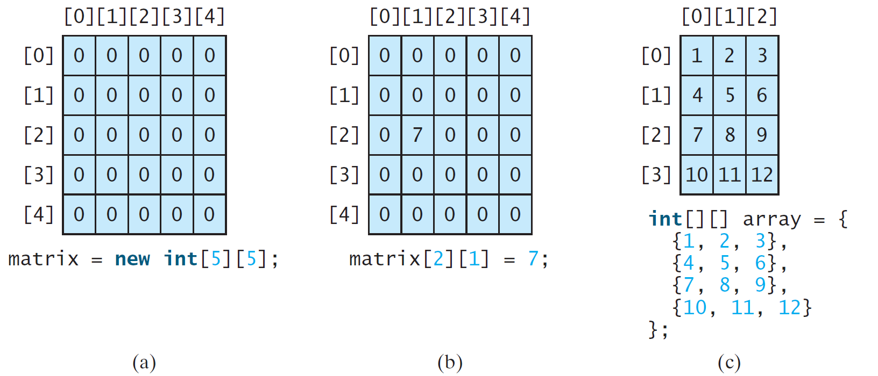
Two-dimensional Array Illustration
matrix.length? 5
matrix[0].length? 5
array.length? 4
array[0].length? 3

Slide 8
Declaring, Creating, and Initializing Using Shorthand Notations
You can also use an array initializer to declare, create and initialize a two-dimensional array. For example,
int[][] array = {
{1, 2, 3},
{4, 5, 6},
{7, 8, 9},
{10, 11, 12}
};
int[][] array = new int[4][3];
array[0][0] = 1; array[0][1] = 2; array[0][2] = 3;
array[1][0] = 4; array[1][1] = 5; array[1][2] = 6;
array[2][0] = 7; array[2][1] = 8; array[2][2] = 9;
array[3][0] = 10; array[3][1] = 11; array[3][2] = 12;
Same as

Slide 9
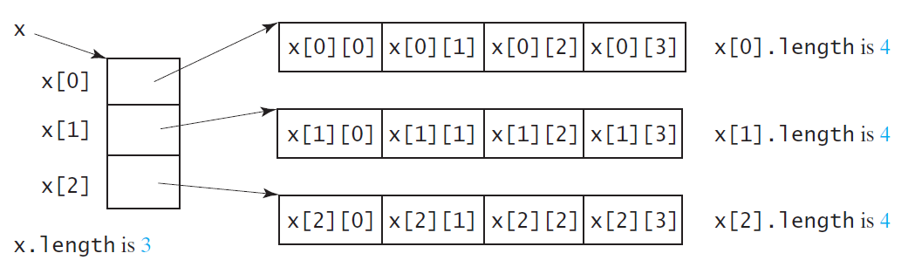
Lengths of Two-dimensional Arrays
int[][] x = new int[3][4];

Slide 10
Lengths of Two-dimensional Arrays, cont.
int[][] array = {
{1, 2, 3},
{4, 5, 6},
{7, 8, 9},
{10, 11, 12}
};
array.length
array[0].length
array[1].length
array[2].length
array[3].length
array[4].length ArrayIndexOutOfBoundsException

Slide 11
Ragged Arrays
Each row in a two-dimensional array is itself an array. So, the rows can have different lengths. Such an array is known as a ragged array. For example,
int[][] matrix = {
{1, 2, 3, 4, 5},
{2, 3, 4, 5},
{3, 4, 5},
{4, 5},
{5}
};
matrix.length is 5
matrix[0].length is 5
matrix[1].length is 4
matrix[2].length is 3
matrix[3].length is 2
matrix[4].length is 1

Slide 12
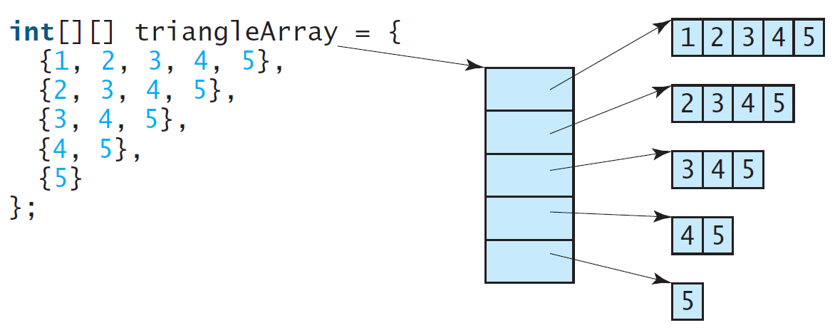
Ragged Arrays, cont.

Slide 13
☑ Check Point
Declare an array reference variable for a two-dimensional array of int values, create a 4 × 5 int matrix, and assign it to the variable.
Can the rows in a two-dimensional array have different lengths?
<--- ANSWER --->
int[][] m = new int[4][5];
Yes. They are ragged array.

Slide 14
☑ Check Point
What is the output of the following code? int[][] array = new int[5][6]; int[] x = {1, 2}; array[0] = x; System.out.println("array[0][1] is " + array[0][1]);
<--- ANSWER --->
array[0][1] is 2.

Slide 15
☑ Check Point
Which of the following statements are valid? int[][] r = new int[2];
int[] x = new int[];
int[][] y = new int[3][];
int[][] z = {{1, 2}};
int[][] m = {{1, 2}, {2, 3}};
int[][] n = {{1, 2}, {2, 3}, };
<--- ANSWER --->
Invalid
Invalid
Valid
Valid
Valid
Invalid

Slide 16
Processing Two-Dimensional Arrays
See the examples in the text.
(Initializing arrays with input values)
(Printing arrays)
(Summing all elements)
(Summing all elements by column)
(Which row has the largest sum)
(Finding the smallest index of the largest element)
(Random shuffling)

Slide 17
Initializing arrays with input values
java.util.Scanner input = new Scanner(System.in);
System.out.println("Enter " + matrix.length + " rows and " +
matrix[0].length + " columns: ");
for (int row = 0; row < matrix.length; row++) {
for (int column = 0; column < matrix[row].length; column++) {
matrix[row][column] = input.nextInt();
}
}

Slide 18
Initializing arrays with random values
for (int row = 0; row < matrix.length; row++) {
for (int column = 0; column < matrix[row].length; column++) {
matrix[row][column] = (int)(Math.random() * 100);
}
}

Slide 19
Printing arrays
for (int row = 0; row < matrix.length; row++) {
for (int column = 0; column < matrix[row].length; column++) {
System.out.print(matrix[row][column] + " ");
}
System.out.println();
}

Slide 20
Summing all elements
int total = 0;
for (int row = 0; row < matrix.length; row++) {
for (int column = 0; column < matrix[row].length; column++) {
total += matrix[row][column];
}
}

Slide 21
Summing elements by column
for (int column = 0; column < matrix[0].length; column++) {
int total = 0;
for (int row = 0; row < matrix.length; row++)
total += matrix[row][column];
System.out.println("Sum for column " + column + " is "
+ total);
}

Slide 22
Random shuffling
for (int i = 0; i < matrix.length; i++) {
for (int j = 0; j < matrix[i].length; j++) {
int i1 = (int)(Math.random() * matrix.length);
int j1 = (int)(Math.random() * matrix[i].length);
// Swap matrix[i][j] with matrix[i1][j1]
int temp = matrix[i][j];
matrix[i][j] = matrix[i1][j1];
matrix[i1][j1] = temp;
}
}

Slide 23
☑ Check Point
Show the output of the following code: int[][] array = {{1, 2}, {3, 4}, {5, 6}}; for (int i = array.length - 1; i >= 0; i--) { for (int j = array[i].length - 1; j >= 0; j--) System.out.print(array[i][j] + " "); System.out.println(); }
<--- ANSWER --->
6 5 4 3 2 1

Slide 24
☑ Check Point
Show the output of the following code: int[][] array = {{1, 2}, {3, 4}, {5, 6}}; int sum = 0; for (int i = 0; i < array.length; i++) sum += array[i][0]; System.out.println(sum);
<--- ANSWER --->
9

Slide 25
Passing Two-Dimensional Arrays to Methods
PassTwoDimensionalArray
Run

Slide 26
☑ Check Point
Show the output of the following code: public class Test { public static void main(String[] args) { int[][] array = {{1, 2, 3, 4}, {5, 6, 7, 8}}; System.out.println(m1(array)[0]); System.out.println(m1(array)[1]); } public static int[] m1(int[][] m) { int[] result = new int[2]; result[0] = m.length; result[1] = m[0].length; return result; } }
<--- ANSWER --->
2 4

Slide 27
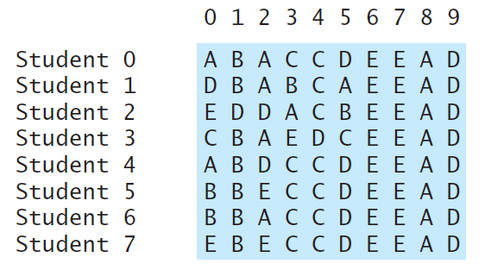
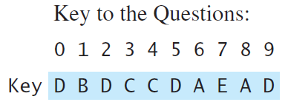
Problem: Grading Multiple-Choice Test
Students’ answer
Objective: write a program that grades multiple-choice test.
PassTwoDimensionalArray
Run

Slide 28
☑ Check Point
1 public class GradeExam {
2 /** Main method */
3 public static void main(String[] args) {
4 // Students' answers to the questions
5 char[][] answers = {
6 {'A', 'B', 'A', 'C', 'C', 'D', 'E', 'E', 'A', 'D'},
7 {'D', 'B', 'A', 'B', 'C', 'A', 'E', 'E', 'A', 'D'},
8 {'E', 'D', 'D', 'A', 'C', 'B', 'E', 'E', 'A', 'D'},
9 {'C', 'B', 'A', 'E', 'D', 'C', 'E', 'E', 'A', 'D'},
10 {'A', 'B', 'D', 'C', 'C', 'D', 'E', 'E', 'A', 'D'},
11 {'B', 'B', 'E', 'C', 'C', 'D', 'E', 'E', 'A', 'D'},
12 {'B', 'B', 'A', 'C', 'C', 'D', 'E', 'E', 'A', 'D'},
13 {'E', 'B', 'E', 'C', 'C', 'D', 'E', 'E', 'A', 'D'}};
14
15 // Key to the questions
16 char[] keys = {'D', 'B', 'D', 'C', 'C', 'D', 'A', 'E', 'A', 'D'};
17
18 // Grade all answers
19 for (int i = 0; i < answers.length; i++) {
20 // Grade one student
21 int correctCount = 0;
22 for (int j = 0; j < answers[i].length; j++) {
23 if (answers[i][j] == keys[j])
24 correctCount++;
25 }
26
27 System.out.println("Student " + i + "'s correct count is " +
28 correctCount);
29 }
30 }
31 }
How do you modify the code so that it also displays the highest count and the student with the highest count? <--- ANSWER --->
Introduce variables highestCount and studentNumberOfHighestCount with initial values -1 and -1. Once a new count is obtained for a student, update highestCount and studentNumberOfHighestCount if the new count is larger than highestCount.

Slide 29
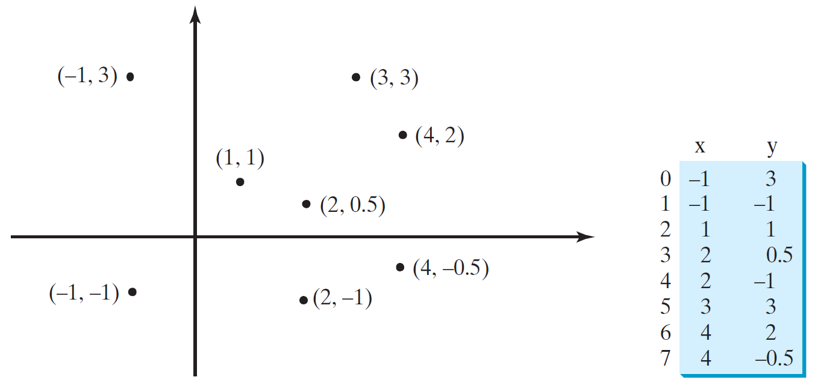
Problem: Finding Two Points Nearest to Each Other
https://liveexample.pearsoncmg.com/dsanimation/ClosestPaireBook.html
PassTwoDimensionalArray
Run

Slide 30
☑ Check Point
1 import java.util.Scanner;
2
3 public class FindNearestPoints {
4 public static void main(String[] args) {
5 Scanner input = new Scanner(System.in);
6 System.out.print("Enter the number of points: ");
7 int numberOfPoints = input.nextInt();
8
9 // Create an array to store points
10 double[][] points = new double[numberOfPoints][2];
11 System.out.print("Enter " + numberOfPoints + " points: ");
12 for (int i = 0; i < points.length; i++) {
13 points[i][0] = input.nextDouble();
14 points[i][1] = input.nextDouble();
15 }
16
17 // p1 and p2 are the indices in the points' array
18 int p1 = 0, p2 = 1; // Initial two points
19 double shortestDistance = distance(points[p1][0], points[p1][1],
20 points[p2][0], points[p2][1]); // Initialize shortestDistance
21
22 // Compute distance for every two points
23 for (int i = 0; i < points.length; i++) {
24 for (int j = i + 1; j < points.length; j++) {
25 double distance = distance(points[i][0], points[i][1],
26 points[j][0], points[j][1]); // Find distance
27
28 if (shortestDistance > distance) {
29 p1 = i; // Update p1
30 p2 = j; // Update p2
31 shortestDistance = distance; // Update shortestDistance
32 }
33 }
34 }
35
36 // Display result
37 System.out.println("The closest two points are " +
38 "(" + points[p1][0] + ", " + points[p1][1] + ") and (" +
39 points[p2][0] + ", " + points[p2][1] + ")");
40 }
4142 /** Compute the distance between two points (x1, y1) and (x2, y2)*/
43 public static double distance(
44 double x1, double y1, double x2, double y2) {
45 return Math.sqrt((x2 - x1) * (x2 - x1) + (y2 - y1) * (y2 - y1));
46 }
47 }
What happens if the input has only one point? <--- ANSWER --->
There will be a runtime exception in lines 19-20 when it references points[p2][0] for p2 is 1.

Slide 31
What is Sudoku?
https://liveexample.pearsoncmg.com/dsanimation/Sudoku.html

Slide 32
Every row contains the numbers 1 to 9

Slide 33
Every column contains the numbers 1 to 9
5 3
4
6
7
8
9
1
2
6
7
2
1 9 5
3
4
8
1
9 8
3
4
2
5
6
7
8
5
9
7
6
1
4
2
3
4
2
6
8
5
3
7
9
1
7
1
3
9
2
4
8
5
6
9
6
1
5
3
7
2
8
4
2
8
7
4 1 9
6
3
5
3
4
5
2
8
6
1
7 9

Slide 34
Every 3×3 box contains the numbers 1 to 9
5 3
4
6
7
8
9
1
2
6
7
2
1 9 5
3
4
8
1
9 8
3
4
2
5
6
7
8
5
9
7
6
1
4
2
3
4
2
6
8
5
3
7
9
1
7
1
3
9
2
4
8
5
6
9
6
1
5
3
7
2
8
4
2
8
7
4 1 9
6
3
5
3
4
5
2
8
6
1
7 9

Slide 35
Checking Whether a Solution Is Correct
CheckSudokuSolution
Run

Slide 36
☑ Check Point
1 import java.util.Scanner;
2
3 public class CheckSudokuSolution {
4 public static void main(String[] args) {
5 // Read a Sudoku solution
6 int[][] grid = readASolution();
7
8 System.out.println(isValid(grid) ? "Valid solution" :
9 "Invalid solution");
10 }
11
12 /** Read a Sudoku solution from the console */
13 public static int[][] readASolution() {
14 // Create a Scanner
15 Scanner input = new Scanner(System.in);
16
17 System.out.println("Enter a Sudoku puzzle solution:");
18 int[][] grid = new int[9][9];
19 for (int i = 0; i < 9; i++)
20 for (int j = 0; j < 9; j++)
21 grid[i][j] = input.nextInt();
22
23 return grid;
24 }
25
26 /** Check whether a solution is valid */
27 public static boolean isValid(int[][] grid) {
28 for (int i = 0; i < 9; i++)
29 for (int j = 0; j < 9; j++)
30 if (grid[i][j] < 1 || grid[i][j] > 9
31 || !isValid(i, j, grid))
32 return false;
33 return true; // The solution is valid
34 }
35
36 /** Check whether grid[i][j] is valid in the grid */
37 public static boolean isValid(int i, int j, int[][] grid) {
38 // Check whether grid[i][j] is unique in i's row
39 for (int column = 0; column < 9; column++)
40 if (column != j && grid[i][column] == grid[i][j])
41 return false;
42
43 // Check whether grid[i][j] is unique in j's column
44 for (int row = 0; row < 9; row++)
45 if (row != i && grid[row][j] == grid[i][j])
46 return false;
47
48 // Check whether grid[i][j] is unique in the 3-by-3 box
49 for (int row = (i / 3) * 3; row < (i / 3) * 3 + 3; row++)
50 for (int col = (j / 3) * 3; col < (j / 3) * 3 + 3; col++)
51 if (row != i && col != j && grid[row][col] == grid[i][j])
52 return false;
53
54 return true; // The current value at grid[i][j] is valid
55 }
56 }
What happens if the code in line 51 is changed to if (row != i && col != j && grid[row][col] == grid[i][j]) ? <--- ANSWER --->
The code in lines 49-52 checks if there is another cell in the 3 by 3 box for grid[i][j] that contains the same value as grid[i][j]. It tests each cell at (row, col) in this 3 by 3 box to see if grid[row][col] == grid[i][j] except the cell at (i, j). This 3 by 3 box has nine cells. Since grid[i][j] itself needs to be excluded, we need to check eight cells. If the code is changed like this, you will only check four cells because the cells in the same row as i would not be checked and the cells in the same column as j would not be checked. The correct code is if (!(row == i && col == j) && grid[row][col] == grid[i][j]) This checks every cell in the 3 by 3 box except the cell for grid[i][j] itself.

Slide 37
Multidimensional Arrays
Occasionally, you will need to represent n-dimensional data structures. In Java, you can create n-dimensional arrays for any integer n.
The way to declare two-dimensional array variables and create two-dimensional arrays can be generalized to declare n-dimensional array variables and create n-dimensional arrays for n >= 3.

Slide 38
Multidimensional Arrays
double[][][] scores = {
{{7.5, 20.5}, {9.0, 22.5}, {15, 33.5}, {13, 21.5}, {15, 2.5}},
{{4.5, 21.5}, {9.0, 22.5}, {15, 34.5}, {12, 20.5}, {14, 9.5}},
{{6.5, 30.5}, {9.4, 10.5}, {11, 33.5}, {11, 23.5}, {10, 2.5}},
{{6.5, 23.5}, {9.4, 32.5}, {13, 34.5}, {11, 20.5}, {16, 7.5}},
{{8.5, 26.5}, {9.4, 52.5}, {13, 36.5}, {13, 24.5}, {16, 2.5}},
{{9.5, 20.5}, {9.4, 42.5}, {13, 31.5}, {12, 20.5}, {16, 6.5}}
};

Slide 39
Problem: Calculating Total Scores
Objective: write a program that calculates the total score for students in a class.
Suppose the scores are stored in a three-dimensional array named scores.
The first index in scores refers to a student, the second refers to an exam, and the third refers to the part of the exam.
Suppose there are 7 students, 5 exams, and each exam has two parts--the multiple-choice part and the programming part.
So, scores[i][j][0] represents the score on the multiple-choice part for the i’s student on the j’s exam.
Your program displays the total score for each student.
TotalScore
Run

Slide 40
Problem: Weather Information
Suppose a meteorology station records the temperature and humidity at each hour of every day and stores the data for the past ten days in a text file named weather.txt.
Each line of the file consists of four numbers that indicate the day, hour, temperature, and humidity.
Your task is to write a program that calculates the average daily temperature and humidity for the 10 days.
Weather
Run

Slide 41
Problem: Guessing Birthday
Listing 4.3, GuessBirthday.java, gives a program that guesses a birthday.
The program can be simplified by storing the numbers in five sets in a three-dimensional array, and it prompts the user for the answers using a loop.
GuessBirthdayUsingArray
Run

Slide 42
☑ Check Point
Declare an array variable for a three-dimensional array m, create a 4 × 6 × 5 int array, and assign its reference to the variable.
Assume char[][][] x = new char[12][5][2], how many elements are in the array?
What are x.length, x[2].length, and x[0][0].length?
Show the output of the following code: int[][][] array = {{{1, 2}, {3, 4}}, {{5, 6},{7, 8}}}; System.out.println(array[0][0][0]); System.out.println(array[1][1][1]);
<--- ANSWER --->
int[][][] m = new int[4][6][5];
120
x.length is 12 x[2].length is 5 x[0][0].length is 2
1 8

